Slide 1
WQF7009 EXPLAINABLE AI
ALTERNATIVE ASSESMENT
EXPLAINABILITY OF LESION CLASSIFICATION MODEL

Slide 2
GROUP INFORMATION
GROUP MEMBERS:
  MUHAMMAD HAZIQ FAIZ BIN MOHD RIPIN 24218182

Slide 3

Introduction
We present a deep learning–based skin lesion classification model designed to categorize dermoscopic images into seven clinically relevant classes
GradCAM and occlusion method as xAI methods

Slide 4
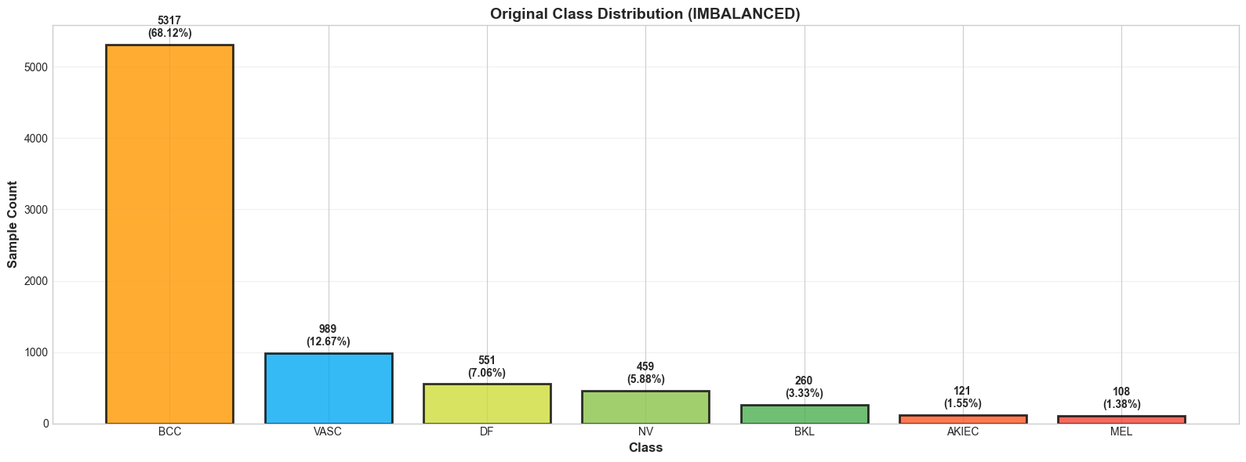
Dataset
The dataset used in this study was obtained from the Skin Lesion Segmentation and Classification collection available on Hugging Face.
Contains 7 classes.
9,547 dermoscopic images in total
The dataset is heavily imbalance

Slide 5
Stakeholder Questions
Clinicians
How confident is the model in this prediction?
Patients
Is this something I should worry about?
Data Scientists
Where does the model fail or show uncertainty?

Slide 6
Class ID | Abbreviation | Lesion Type | Clinical Description
0 | BKL | Benign Keratosis | Non-cancerous, often scaly skin lesions. Common and usually harmless.
1 | NV | Melanocytic Nevi | Regular moles formed by pigment-producing cells. Typically benign.
2 | DF | Dermatofibroma | Firm, small nodules under the skin caused by minor trauma. Non-cancerous.
3 | MEL | Melanoma | A serious and potentially life-threatening skin cancer. Early detection is critical.
4 | VASC | Vascular Lesion | Blood vessel-related lesions such as angiomas; usually red or purple.
5 | BCC | Basal Cell Carcinoma | The most common form of skin cancer; slow-growing and rarely metastasizes.
6 | AKIEC | Actinic Keratoses | Pre-cancerous lesions that may progress to squamous cell carcinoma.

Slide 7
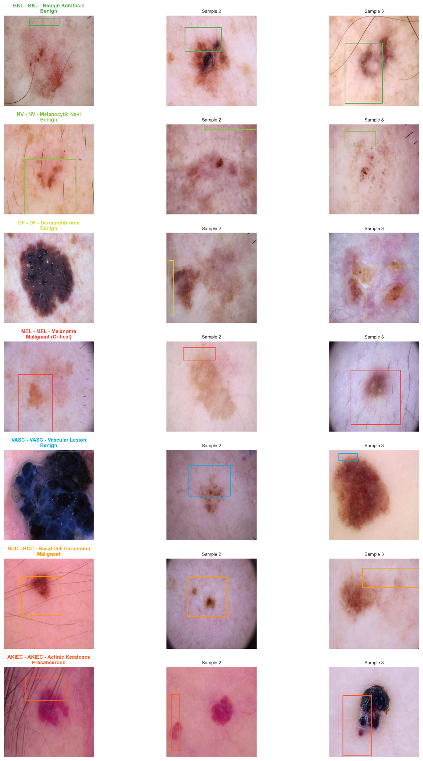
The bounding boxes provided are not accurate.
The same type of lesions can come in multiple colorations and sizes.
Almost all of the patients have fair skin

Slide 8




Dataset Preprocessing
EDA & Gloss Selection
Cleaning & Inspection
Dataset Balancing
Storage
Perform simple EDA
Ensure all image has its corresponding label
Use undersampling to balance the dataset
Post processed dataset stored on Drive for model training
Notes:
can mention: ‘Anak perempuan’ clips mixed in ‘Anak lelaki’ folder

Slide 9
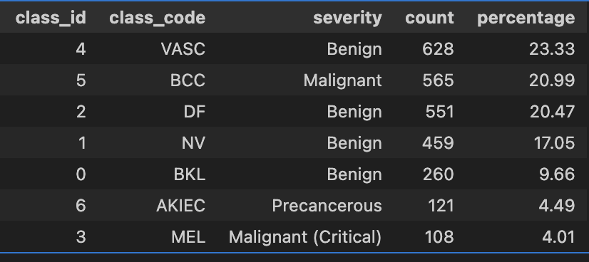
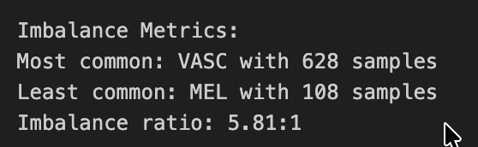
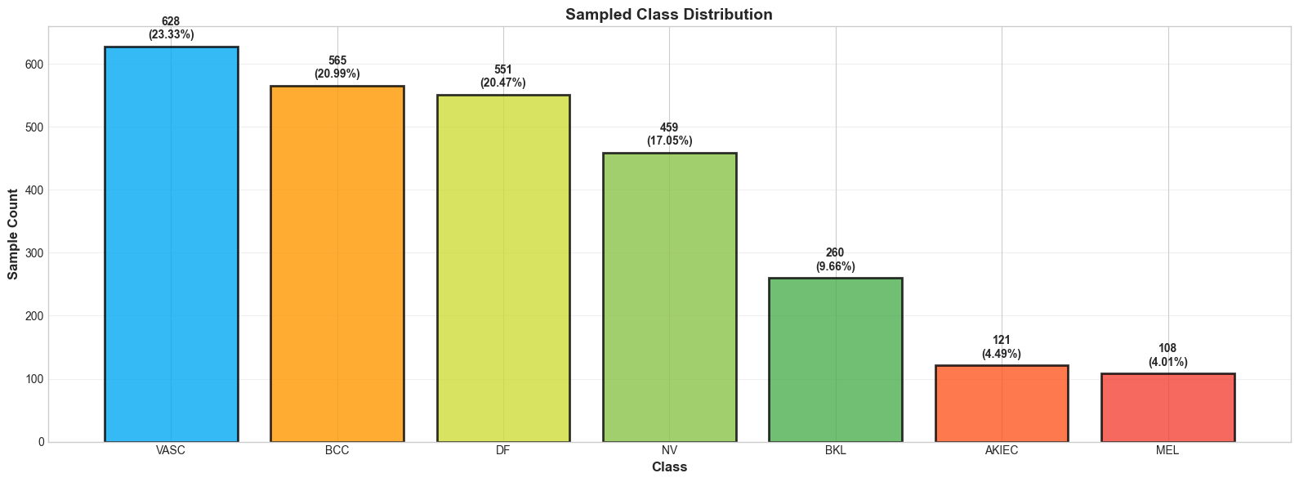

Slide 10
Base Model - Overview
Configuration
Finetune a ResNet18 Model
Replace the final fully connected layer with a new linear classification head consisting of seven output neurons
All convolutional layers of the pretrained backbone were frozen during training
2. Hyper parameter
Early stopping ends at 12th epoch.
Optimizer: ADAM
Learning rate: 1x10^-3
Loss function: Cross Entropy with Weighted Class
2. Evaluation Metric
Weighted Accuracy, Recall and F1 Score

Slide 11
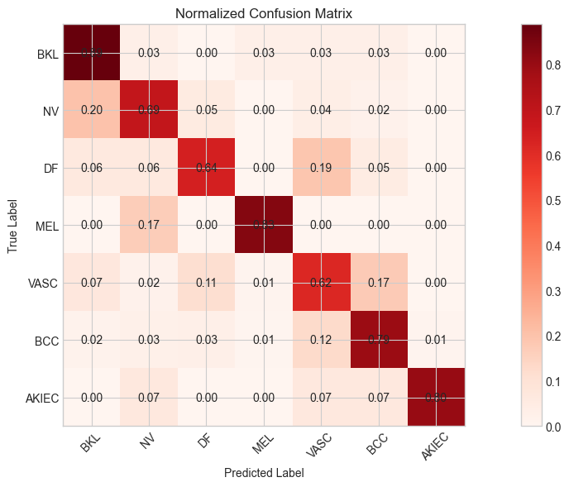
Preliminary Results
Weighted Accuracy | 0.7596
Weighted Recall | 0.7596
Weighted F1 | 0.7770
Class | Precision | Recall | F1 | Support
0 (BKL) | 0.492 | 0.889 | 0.634 | 36
1 (NV) | 0.585 | 0.691 | 0.633 | 55
2 (DF) | 0.539 | 0.641 | 0.586 | 64
3 (MEL) | 0.625 | 0.833 | 0.714 | 12
4 (VASC) | 0.418 | 0.617 | 0.498 | 115
5 (BCC) | 0.953 | 0.792 | 0.865 | 664
6 (AKIEC) | 0.706 | 0.800 | 0.750 | 15

Slide 12
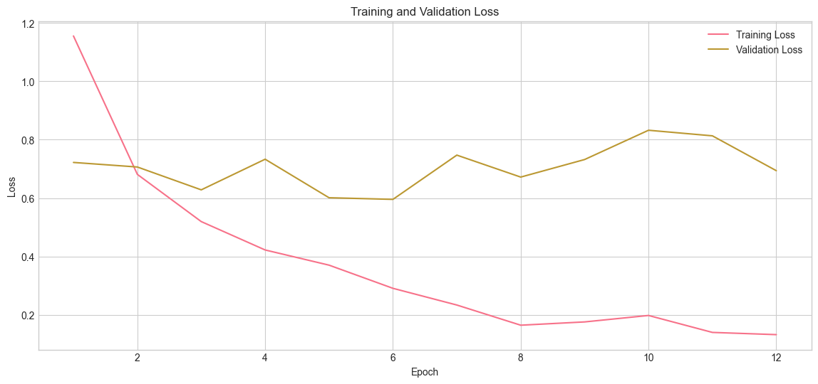
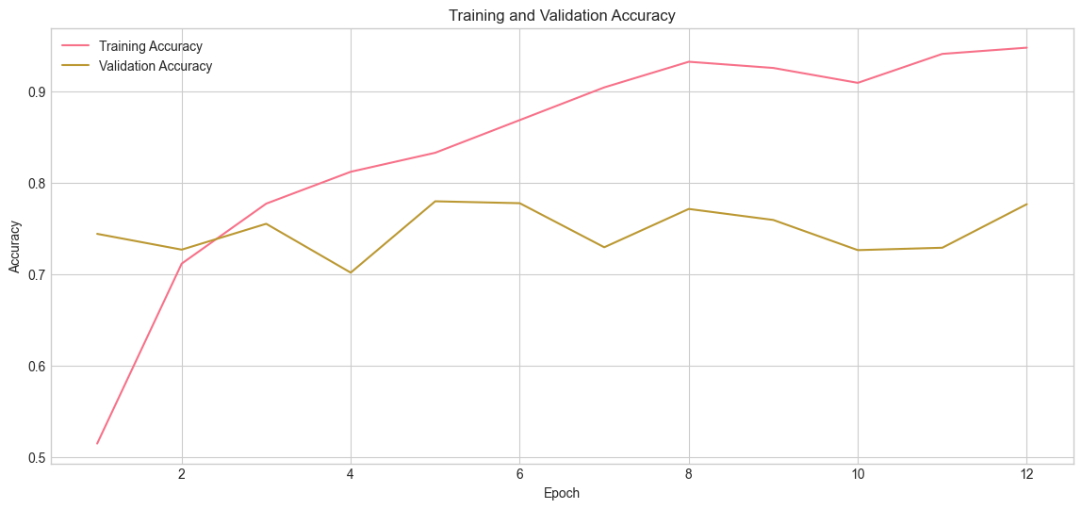
Preliminary Results

Slide 13
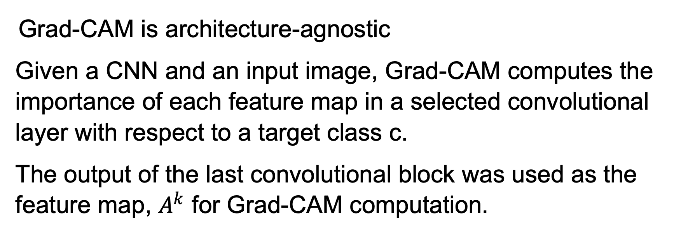
Feature Importance xAI: Grad-CAM
Grad-CAM is architecture-agnostic
Given a CNN and an input image, Grad-CAM computes the importance of each feature map in a selected convolutional layer with respect to a target class c.
The output of the last convolutional block was used as the feature map, $A^{k}$ for Grad-CAM computation.

Slide 14
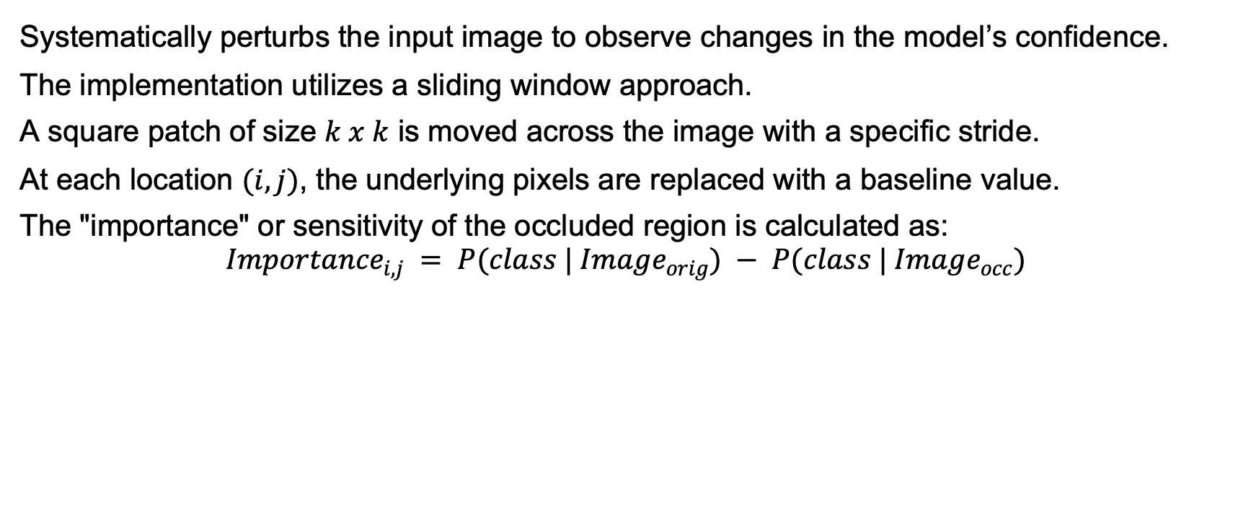
Counter Factual xAI: Occlusion Method
Systematically perturbs the input image to observe changes in the model’s confidence.
The implementation utilizes a sliding window approach.
A square patch of size $k x k$ is moved across the image with a specific stride.
At each location $(i,j)$, the underlying pixels are replaced with a baseline value.
The "importance" or sensitivity of the occluded region is calculated as:
$${Importance}_{i,j} = P(class | {Image}_{orig}) − P(class | {Image}_{occ})$$

Slide 15
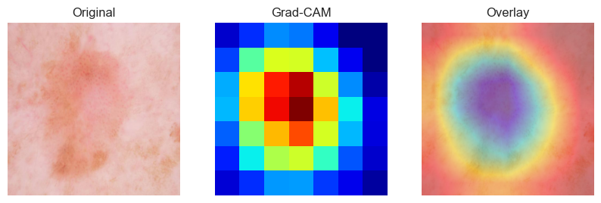
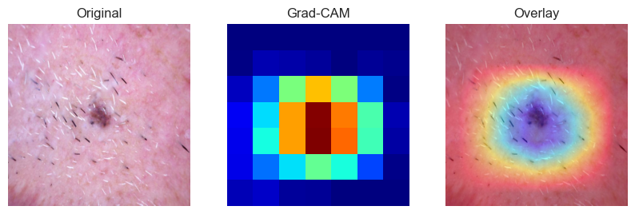
Grad Cam Results
Class 0 : Benign Keratosis
Class 1 : Melanocytic Nevi

Slide 16
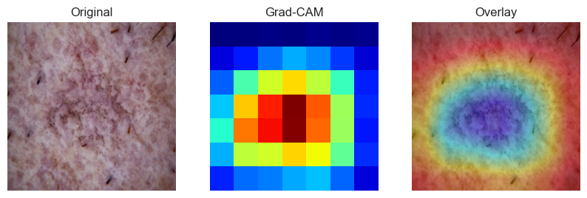
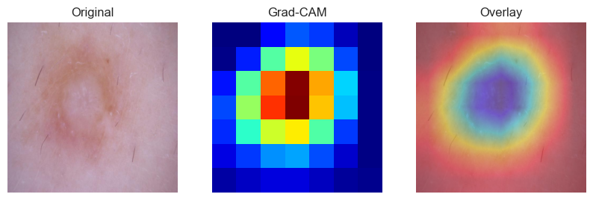
Grad Cam Results
Class 2 : Dermatofibroma
Class 3 : Melanoma

Slide 17
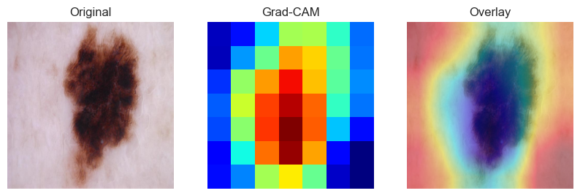
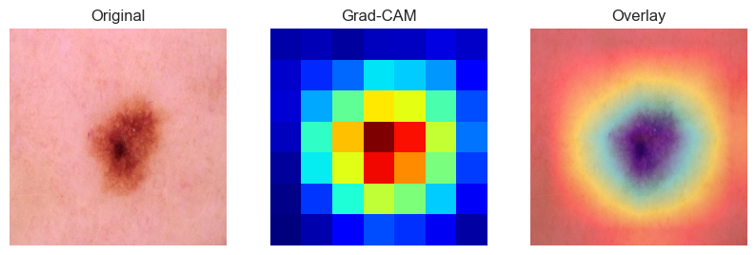
Grad Cam Results
Class 4 : Vascular Lesions
Class 5 : Basal Cell Carcinoma

Slide 18
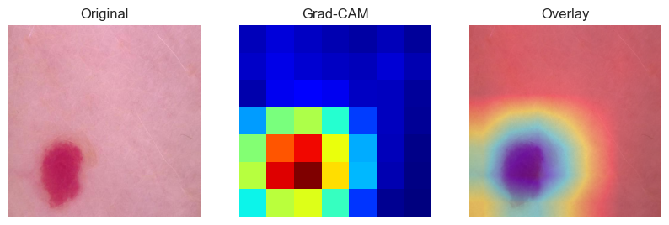
Grad Cam Results
Class 6 : Actinic Keratose

Slide 19
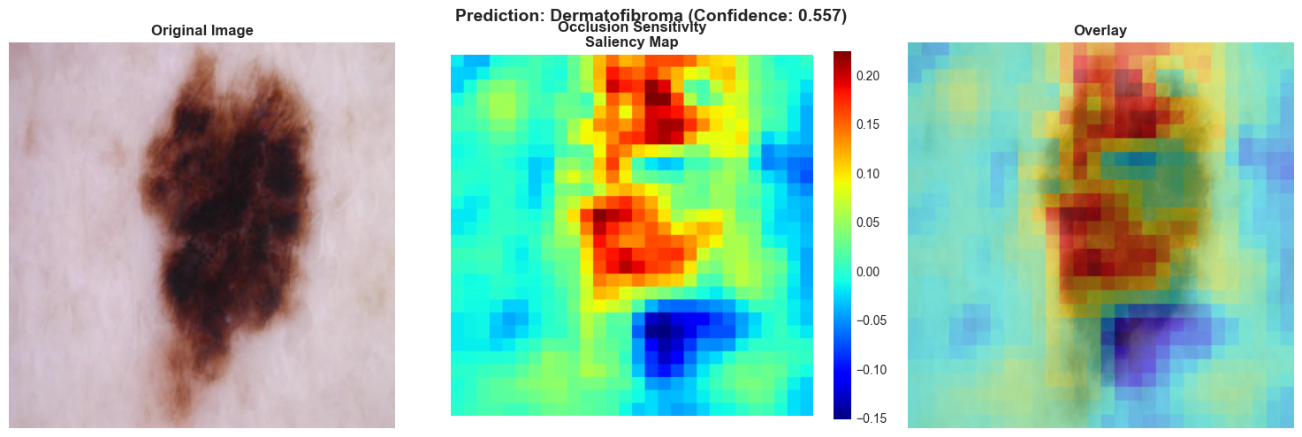
Occlusion Method Results
Correctly classified as benign keratosis by our model. However, after occlusion method is applied the model classified it as dermatofibroma.

Slide 20
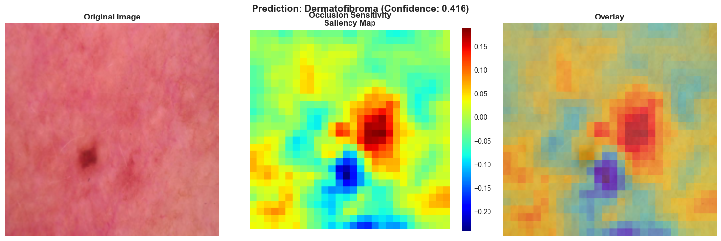
Occlusion Method Results
The model correctly classified it as dermatofibroma but there is a sharp drop in confidence.

Slide 21
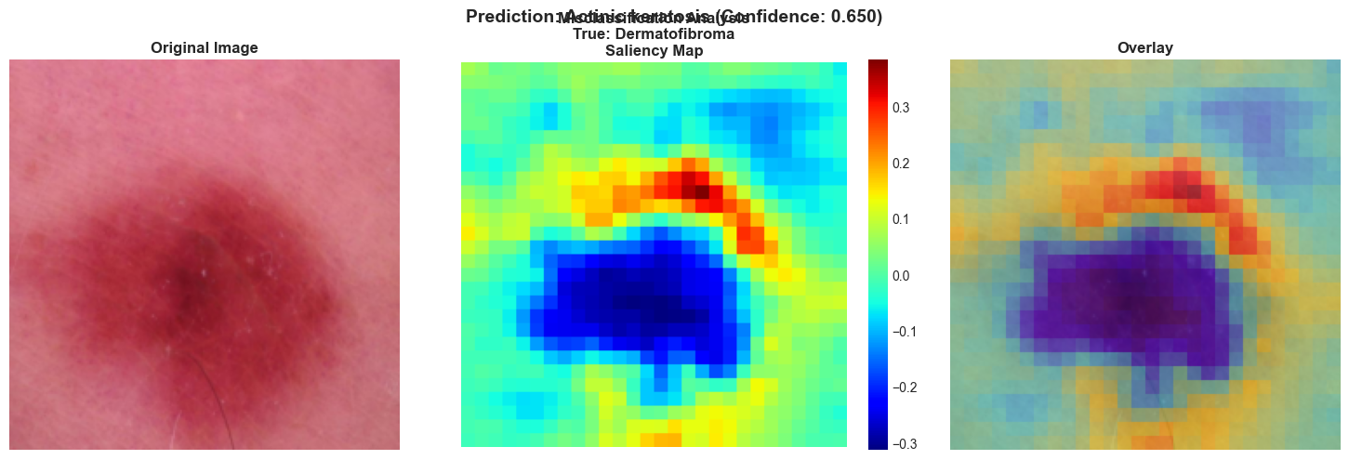
Occlusion Method Results
The model misclassified dermatofibroma as actinic keratosis after occlusion is applied.

Slide 22
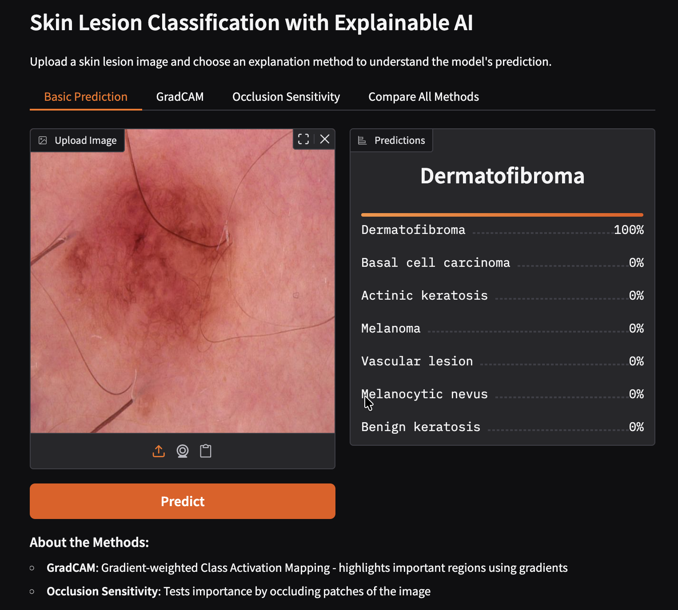
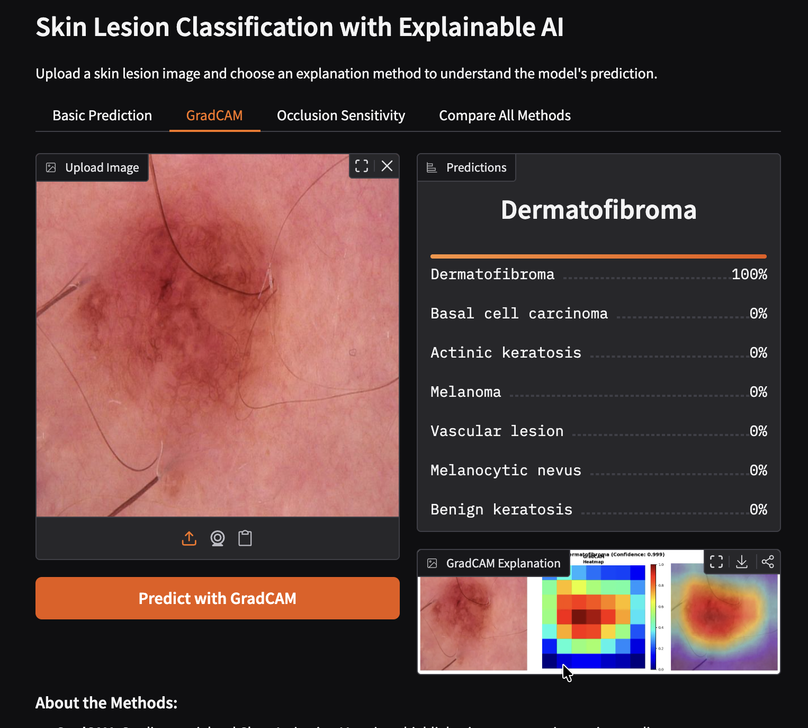
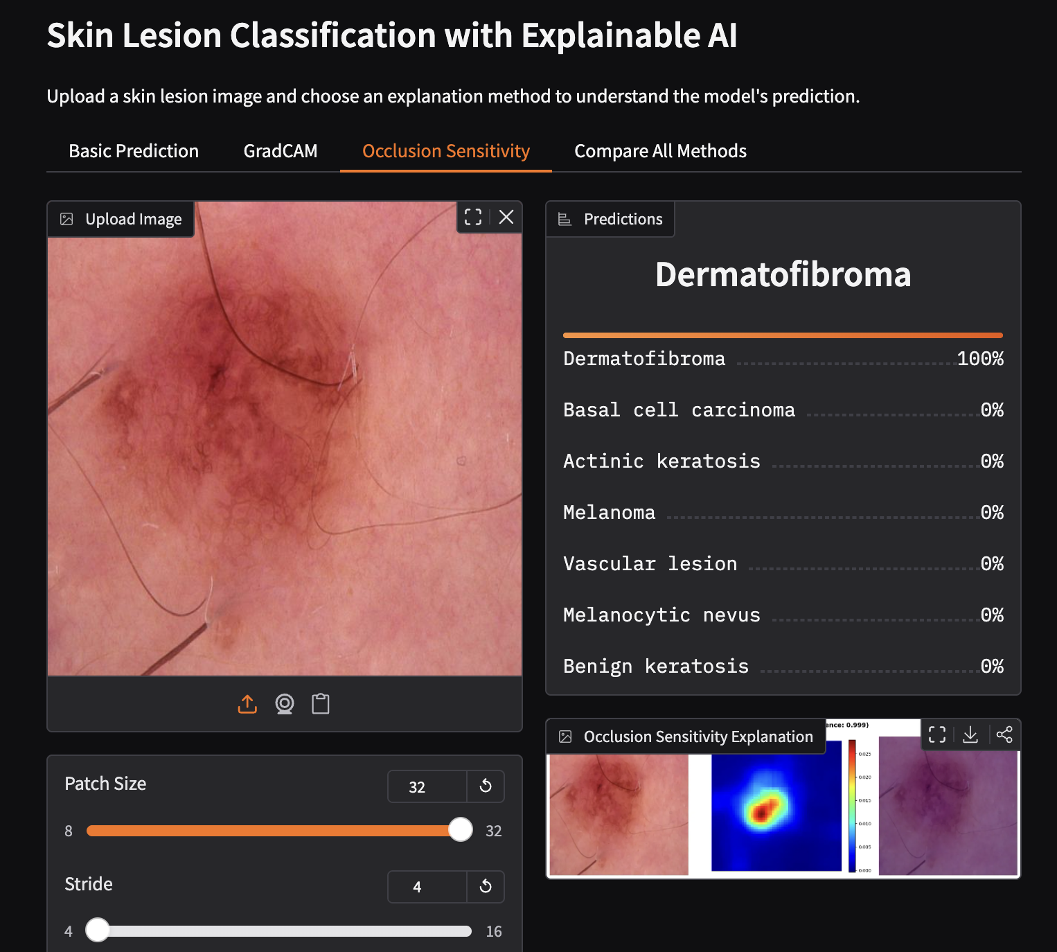
Dashboard

Slide 23
Conclusion
The integration of XAI into skin lesion classification addresses critical barriers to AI adoption in dermatology:
Enhanced Trust
Educational Value
Error Detection
Regulatory Compliance
We proposed two additional steps for the future:
1. Conduct formal studies with practicing dermatologists to evaluate whether XAI explanations improve diagnostic accuracy, confidence, and decision-making efficiency.
2. A holistic comparison between the full results from our model and our counterfactual method.

Slide 24
Thank you

